Slide 1
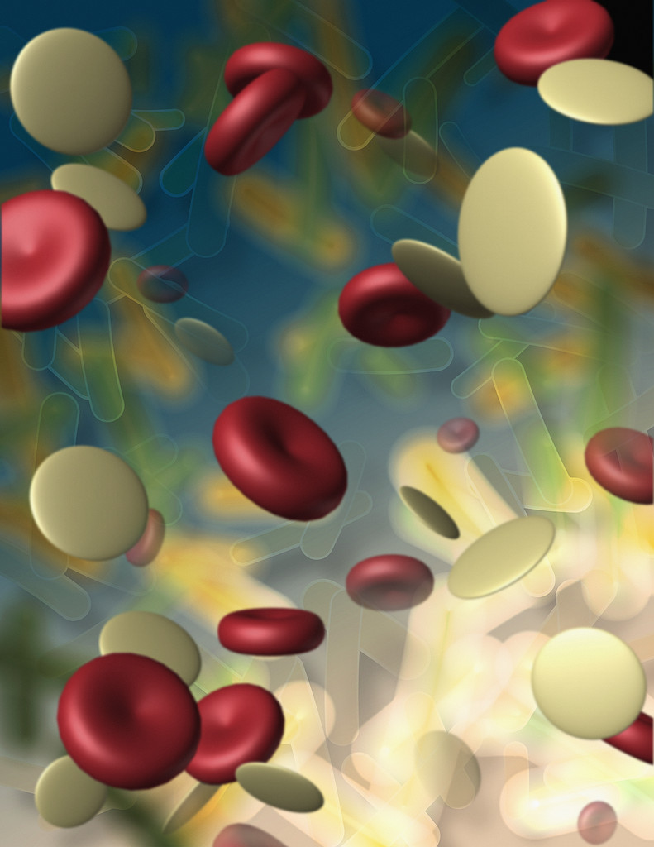
Lymphocytes & Immunity
Clinical Pathology I
VTHT 2323
Lori VanValkenburg, RVT

Slide 2
Lymphocytes
WBC originates from PPSCs in bone marrow
Immature lymphocytes are processed in the Central Lymphoid Organs
  Thymus
  Bone marrow
  GALT (gut-associated lymph tissue)
Mature lymphocytes live in the
Peripheral Lymphoid Organs
  Lymph nodes
  Tonsils
  Bone marrow
  GALT
  Spleen
  Thymus
Fact: The spleen is the largest lymphoid organ in the body.

Slide 3
Lymphocytes…
…are the predominant WBC in cattle and pigs.
…are the only WBC with no phagocytic capabilities.
…can constantly recirculate between tissue and blood.
…may survive for weeks or even years.
…cannot be differentiated morphologically
…can cause leukocytosis.

Slide 4
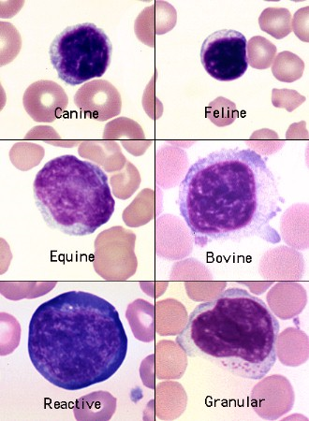

Slide 5
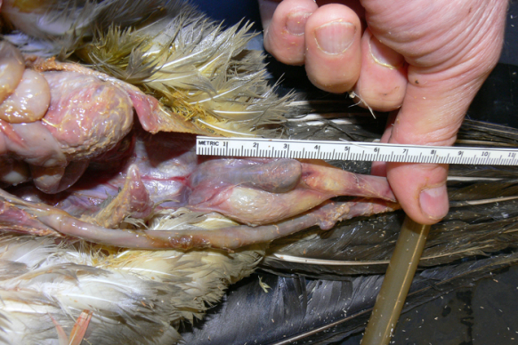
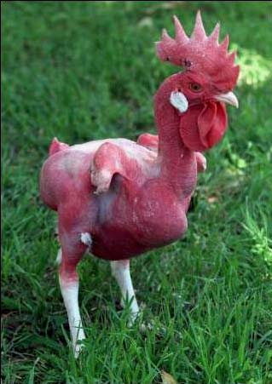
3 Types of Lymphocytes
B – Lymphocytes – “bursa equivalent” Antibody producing lymphocytes, that are involved in humoral immunity.
T – Lymphocytes – “Thymus University Grads” Lymphocytes involved in cellular immunity.
Natural Killer (NK) cells – Neither B nor T lymphocytes that have the ability to kill some types of tumor cells and cells infected with various viruses.

Slide 6
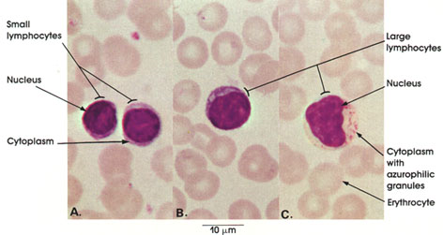
Lymphocyte Normal Ranges
Canine: 1,000 – 4,800 /µL
Feline: 1,500 – 7,000 /µL
The lymphocytes seen in circulation of healthy animals are either classified as being large or small lymphocytes.
Lymphocytes contain no granules in their cytoplasm. They nucleus is round or oval and does not segment. Large lymphocytes have abundant sky-blue cytoplasm. Small lymphocytes often look like nuclei without cytoplasm, or just a small amount may be visible on one side of the nucleus.

Slide 7
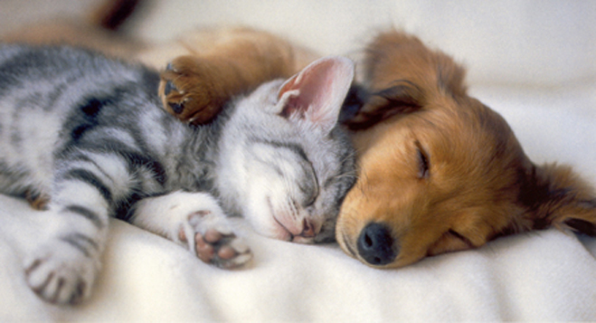
Lymphocytosis
Physiologic: due to epinephrine release.
Common in chronic inflammation
Antigenic stimulation.
Later stages of resolving infections.
Neoplastic lymphocytosis (leukemia and lymphosarcoma)
Youth

Slide 8
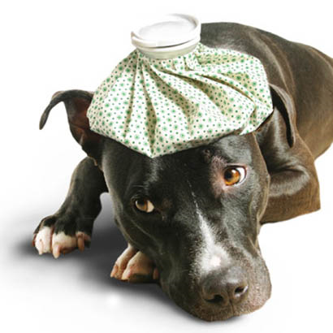
Lymphopenia
One of the most common CBC abnormalities of sick dogs and cats.
Associated with stress.
Immunosuppressive therapy.
Immunodeficiency syndromes.
Acute viral infections

Slide 9

The Immune System
Function: To protect animal from damage/disease.
Recognize “self” from “not self”
Destroy “not-self”
Mechanisms of Destruction
Phagocytosis
Lysis (cell membrane)
Inactivation
Agglutination

Slide 10
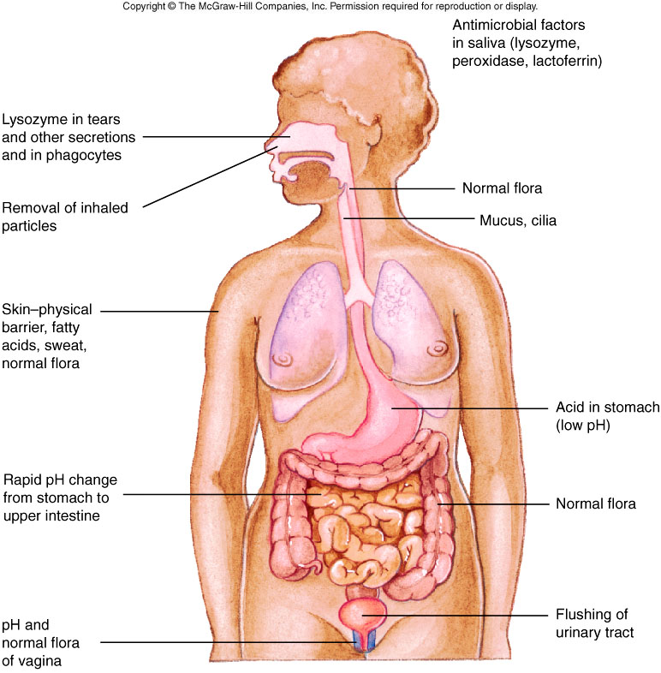
2 Types of Immunity
Non-specific (1st and 2nd Lines of Defense)
Specific (3rd Line of Defense)
Non-Specific Immunity
First Line of Defense
Mechanical Barriers
Chemical Barriers

Slide 11
Second Line of Defense
Inflammatory Response
Phagocytosis (neutrophils, MPS)
Natural Killer (NK) cells
Interferon
Complement

Slide 12
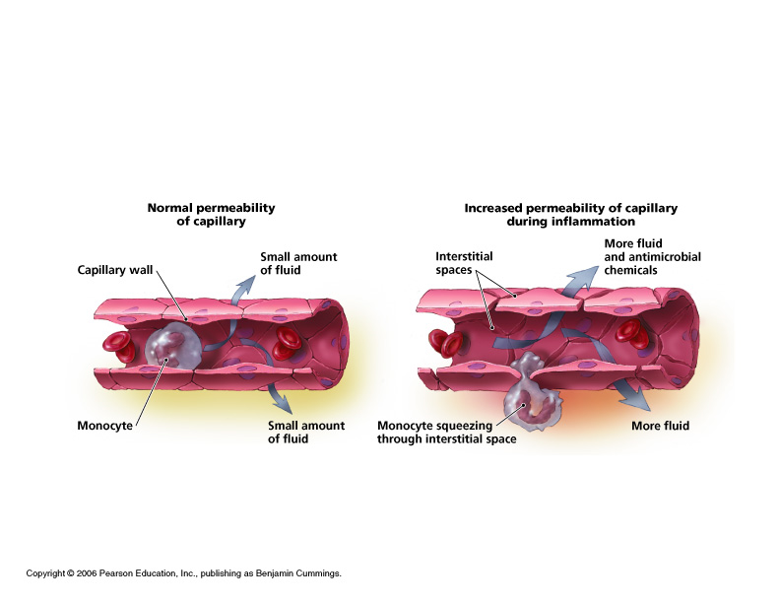
Inflammatory Response

Slide 13
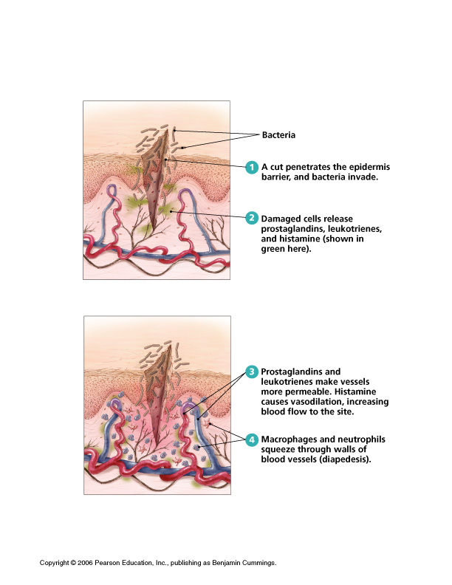
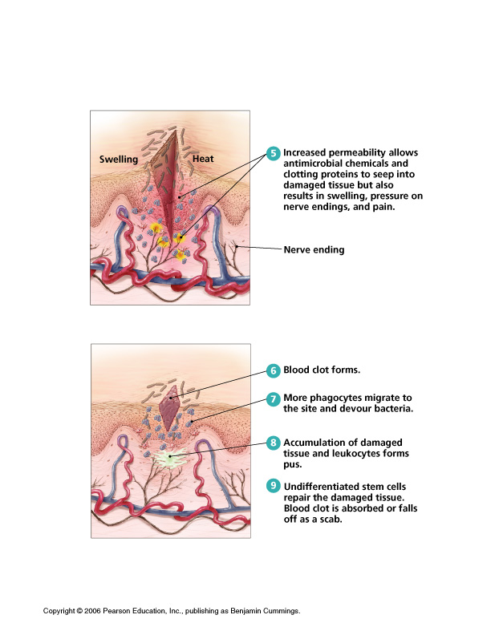

Slide 14
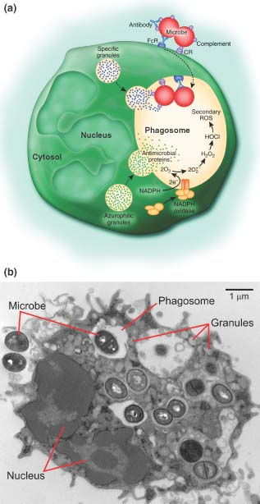
Phagocytosis

Slide 15
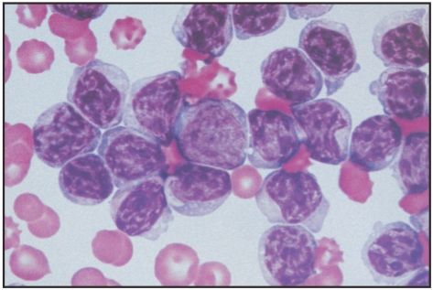
Natural Killer (NK) Cells
…are not T-Lymphocytes or B-Lymphocytes.
…do not have to be activated by a specific antigen.
…can kill some types of cancers and tumor cells.
…can kill some cells infected with particular viruses.
…must come in direct contact with cell before destroying it.

Slide 16
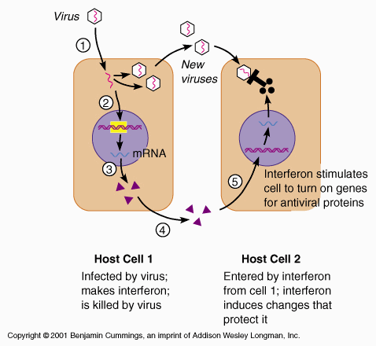
Interferon
…is a protein produced by a cell after it has been infected by a virus.
…responds rapidly to inhibit further development and spread of the virus.

Slide 17
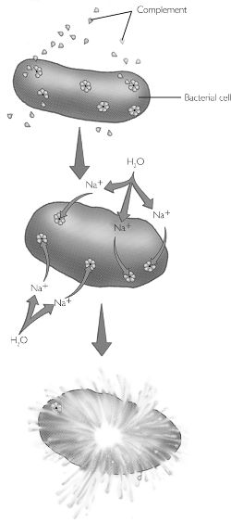
Complement
…refers to a group of inactive enzymes in plasma.
…are activated by attachment of antibody to antigen.
…adhere to complement binding sites on antibodies.
Complement fixation - process by which complement enzymes arrange into doughnut formation on antigen surface, create a hole, allowing sodium and water to enter cell and cause it to swell and burst.

Slide 18
Specific Immunity
The Third Line of Defense
Primarily involves lymphocytes.
Cell-Mediated or Humoral
Properties of all Specific Immune Responses:
Response will be initiated only after the antigen enters the body.
Response will be aimed specifically against the antigen present
If the antigen enters the body a second time, there will be a memory of the antigen and the immune response will occur more quickly.

Slide 19
Cell-Mediated Immunity
Fact: Helper T-cells are the most numerous of the T-cells
A function of T-Lymphocytes
Tissue macrophages required.
Sensitized T-cell transforms into a cytotoxic T-cell (Tc), a helper T-cell (Th), or a supressor T-cell (Ts)
Chemical messengers called cytokines are secreted at the site of infection
T-cells enter circulation and travel to the site where the antigen entered the body.

Slide 20
Humoral Immunity
A function of B-Lymphocytes
B-cells, activated by an antigen-antibody complex produce plasma cells that secrete antibodies into the plasma.
B-cells and plasma cells stay in lymphoid tissue.
Immunoglobulins (antibodies) circulate in bloodstream (in the plasma), destroying antigens.

Slide 21
Antibodies
Five types of antibodies (immunoglobulins) have been identified:
  IgG, IgM, IgA, IgE and IgD
When an antibody attaches to an antigen:
  Antigens may be transformed into harmless substances.
  Antigens may be agglutinated and then phagocytized by macrophages.
  Complement system may be activated
Fact: IgG is present in the greatest quantity of all the immunoglobulins

Slide 22
Memory Cells
Not all activated Lymphocytes become immediately involved in the immune response.
Both T-cells and B-cells are capable of becoming Memory Cells
Memory cells wait for a second infection of the same antigen that triggered their formation.
  May circulate in blood or wait in lymph nodes.
  Some can live for a few days; others for several years.
Second exposure = more rapid & greater degree of response than the first.

